Slide 1
Disclaimer
I’m not an expert, and yet I am. My knowledge comes from navigating difficult, real-life situations. I spend a lot of helping people navigate copyright, and I spend even more time studying written communication. These are the thoughts and observations I’ve made as I grappled with these problems.
I’m excited to talk with those of you who are also may be tired of navigating these difficult situations. I also hope that any experts among us will share insights from their formal studies and contribute to the dialog.
Let’s get started.

Slide 2
Caveat
I am an American citizen, and my presentation is written about a problem that confronts U.S. citizens. I cannot speak for the copyright situation in other countries. However, I think some of my concerns may be shared by people across the globe.

Slide 3
Problem
Currently, most people break this law
People don’t follow copyright
People don’t want to learn how to
People don’t see importance of copyright

Slide 4
Recent memory
“The Stop Online Piracy Act,” or SOPA
“The Preventing Real Online Threats to Economic Creativity and Theft of Intellectual Property Act of 2011,” or PIPA
Millions of Americans told Congressional representatives to vote against them—and they listened!
Notes:
January 18th is when a lot of these problems congealed into thoughts for me. Just to recap what happened on that day…

Slide 5
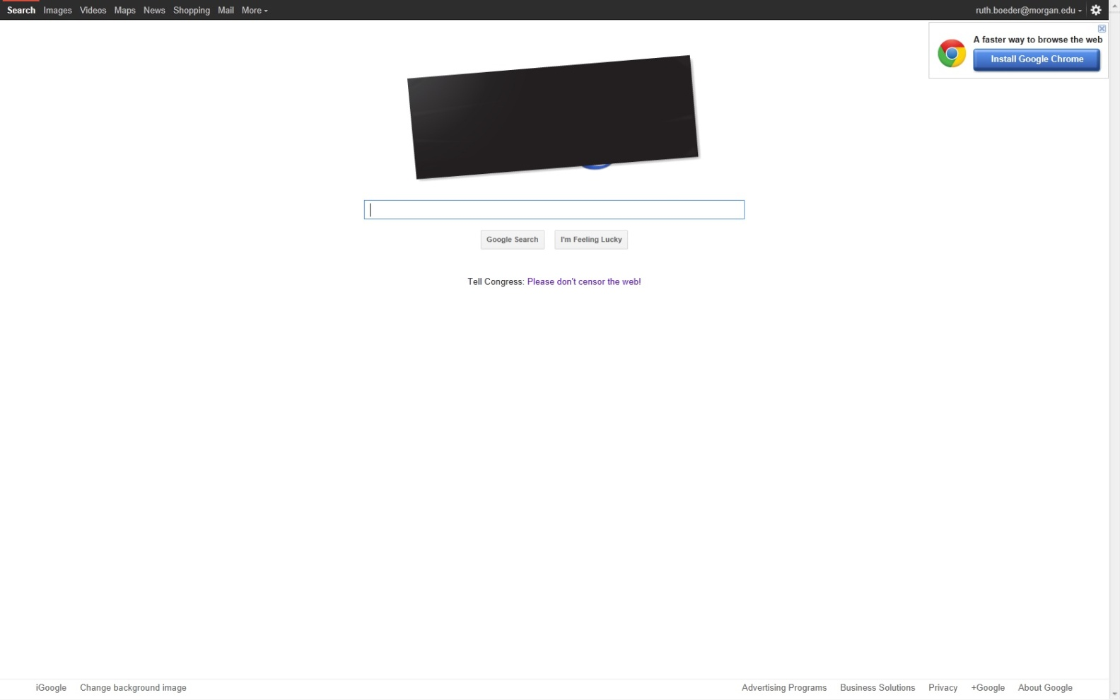
That’s how we got this

Slide 6
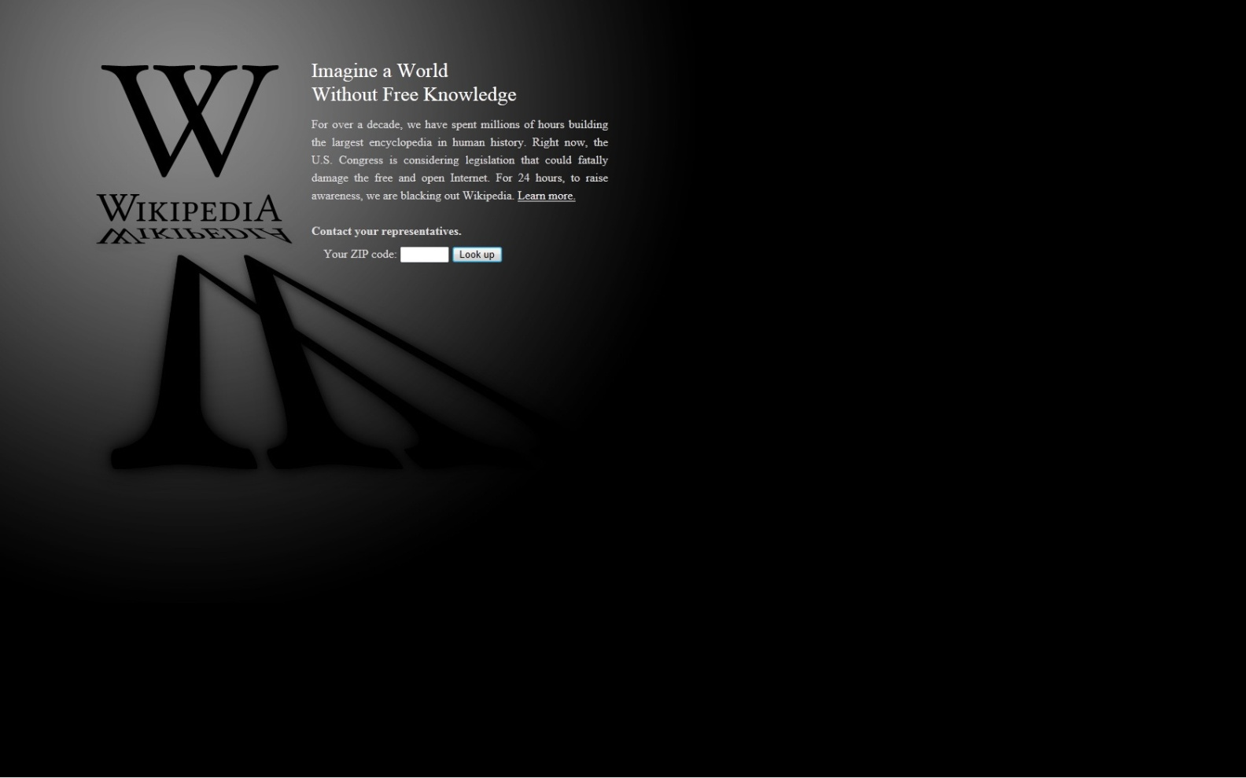
And this

Slide 7
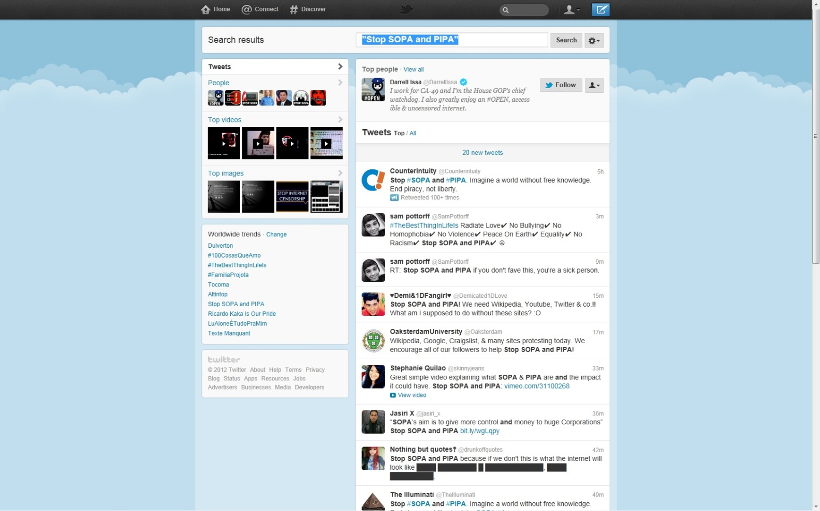
And also this

Slide 8
Did you participate?
Were you part of the Jan. 18 SOPA/PIPA protest? Answer the poll:
Yes
No

Slide 9
What was the big deal?
Copyright holders (usually media corporations) would have been given power to not just sue alleged pirates, but also to
enlist the government to remove revenue sources from websites associated with pirating
prevent search traffic from discovering such websites
destroy the website’s web address
These broad powers of policing would most likely have greatly redacted the amount and fundamentally changed the kind of conversation on the Internet
Lawyers might call this a “chilling effect”
Notes:
This is the threat: that copyright, as a piece of government regulation, could become so broad that it limits or even stifles all creative expression. If that happens, copyright would shoot itself in the foot.

Slide 10
Root causes
19th century design of copyright
Fundamentally open nature of internet
Notes:
This problem didn’t just suddenly arise. Copyright infringement is an old problem—remember Napster? Remember when CDs first came out? Or, remember the 19th century? Copyright law came into existence because of problems then. And while we still have the same problems today, the fundamentally open nature of the internet has complicated the situation. In the next few slides, we’ll talk more about these two root causes of this current copyright conflict.

Slide 11
Timeline of Copyright
Purpose of copyright is to preserve author’s fiscal interests. It didn’t exist until professional, independent authors did.
U.S. copyright began in 19th century; response to pirating of European and British authors
Revisions and expansions through 20th century kept pace with global standards
Notes:
Copyright didn’t exist until the printing press took off in the 16th century. It really became vital after the patronage system crumbled in late 17th-early 18th centuries. In earlier times, when documents were hand-copied, the idea of copyright was nonsensical.
Because of more developed culture, arts and letters, Europe developed copyright. U.S. has played catch-up ever since.

Slide 12
Nature of web communication
Michele Jackson “Fluidity, Promiscuity, and Mash-Ups: New Concepts for the Study of Mobility and Communication”
Contrasts traditional, sender-receiver, closed communication loops with mobile, networked transmissions
“removal of information from its particular context is the essential property of mobility 2.0. Information does not so much travel from one place to another, as much as it exists in a fluid state, able to flow freely and to be appreciated simultaneously in multiple and undetermined ways”
Notes:
Copyright was built for communications that came from person A’s mind, were recorded, and then were consumed by person B’s mind. If Person B wanted to say something back, a new piece of communication went out. The Web is fundamentally different, as scholar Michele Jackson points out. Person B builds directly on Person A’s work.

Slide 13
Importance of web communication
William H. Dutton “The Fifth Estate Emerging through the Network of Networks”
The Fifth Estate is a group of networked individuals exercising power alongside the four traditional groups
“The Fifth Estate allows networked individuals to employ the Internet to increase the accountability of the other Estates…it can also be deployed as an alternative source of authority to professional expertise by offering citizens, patients, students, and others alternative sources of information, analysis, and opinion.”
Notes:
Before you say “So What? That’s just how things are”, here is the difference web communication is making. The networked style of communication is becoming a powerful tool for the common man. The SOPA/PIPA protests were an example of this new fifth estate in action.

Slide 14
Tensions
Possibly overly-broad, definitely simplistic statements:
COPYRIGHT
INTERNET
Copyright keeps one author in control
Copyright values author above society
Internet puts large group in control
Internet values society above author
Notes:
When I say “value” I mean that one thing is empowered at the possible expense of another. One entity is given privileges by limiting the other’s.

Slide 15
Is reconciliation possible?

Slide 16
Possible changes
Redefine and expand fair use
Build up and promote use of Creative Commons Licenses
Scrap copyright and start fresh?
What ideas do you have?
Notes:
Ways to improve the situation, although none of them will be quick or easy. The problem may be too complicated for it—and it probably should be too complicated for quick and easy solutions.

Slide 17
Citations
Dutton, William H. "The Fifth Estate Emerging through the Network of Networks." Prometheus 27.1 (2009): 1-15. Academic Search Complete. Web. 10 Feb. 2012.
Jackson, Michele H. "Fluidity, Promiscuity, and Mash-Ups: New Concepts for the Study of Mobility and Communication." Communication Monographs 74.3 (2007): 408-413. Communication & Mass Media Complete. Web. 9 Feb. 2012.

Slide 18
Contact:
Ruth Boeder
rlboeder@gmail.com

